Slide 1


What value does OSINT bring to the Web 3.0 space?
Some tips and trick to help you live in it…

Slide 2

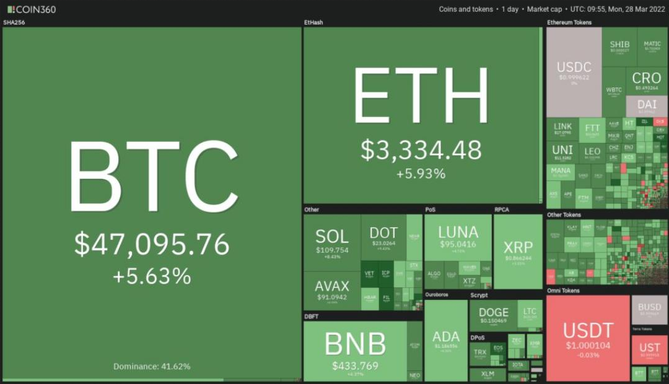
WHOAMI Michael James @ginsberg5150
OSINT Curious
QOMPLX
SecKC

Slide 3
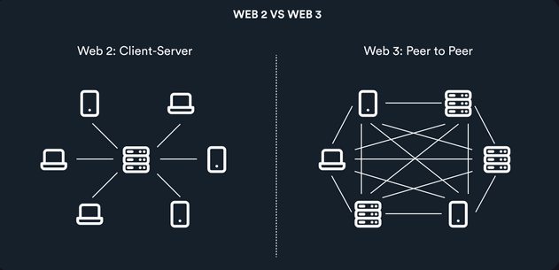
What is Web 3.0?
Semantic Web
Automation Web
Fair amount of pain…

Slide 4
What we will go over in this talk…
Useful Sites
Web3 Related Technologies
DAO/DEFI
ENS/UNS
Traditional OSINT method to help
Tool release

Slide 5
Useful Sites
github.com/Ginsberg5150/Web3 – Glossary and Definitions
ETH Detective
Breadcrumbs app
Crypto logos
Esteroids
Web3isgoinggreat
Tornado.Cash

Slide 6
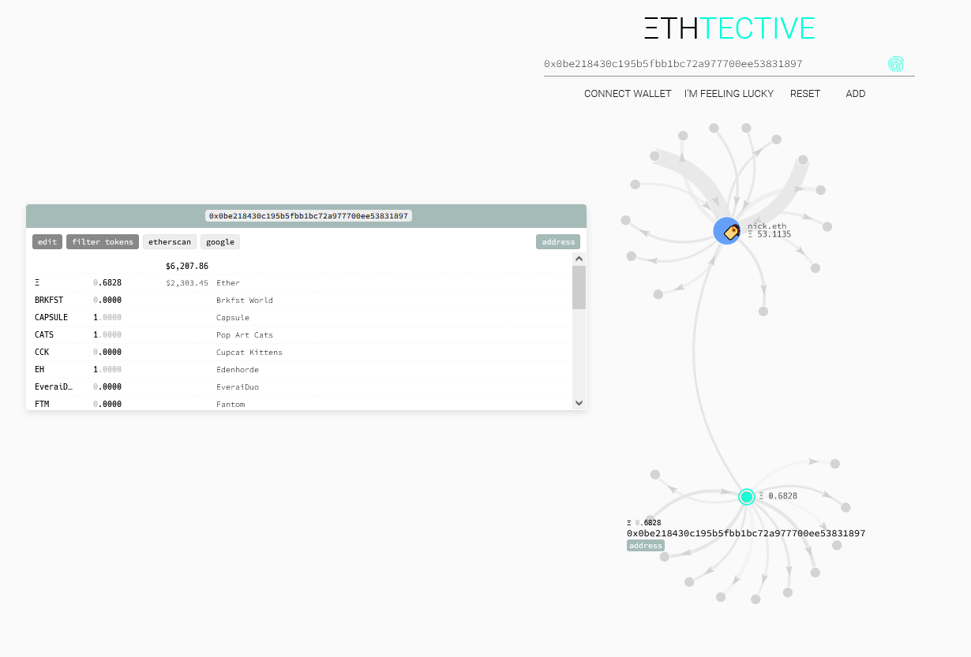
https://ethtective.com/

Slide 7
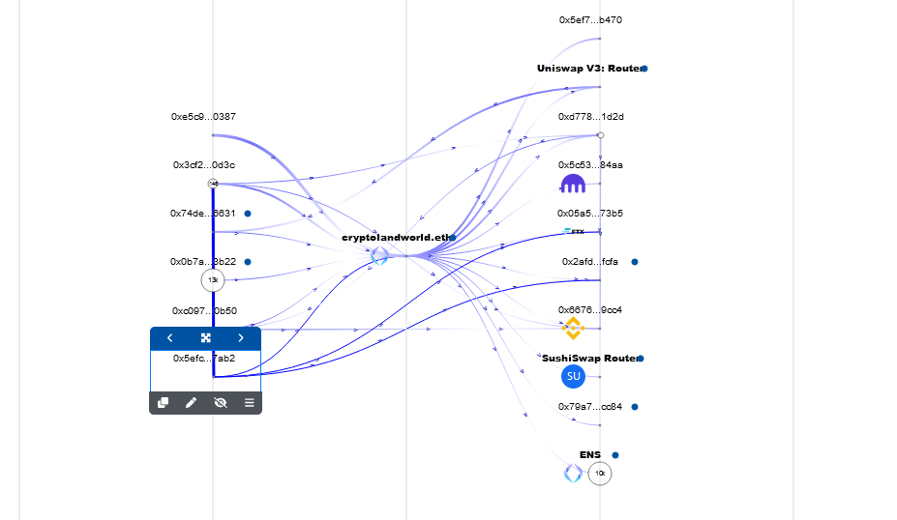
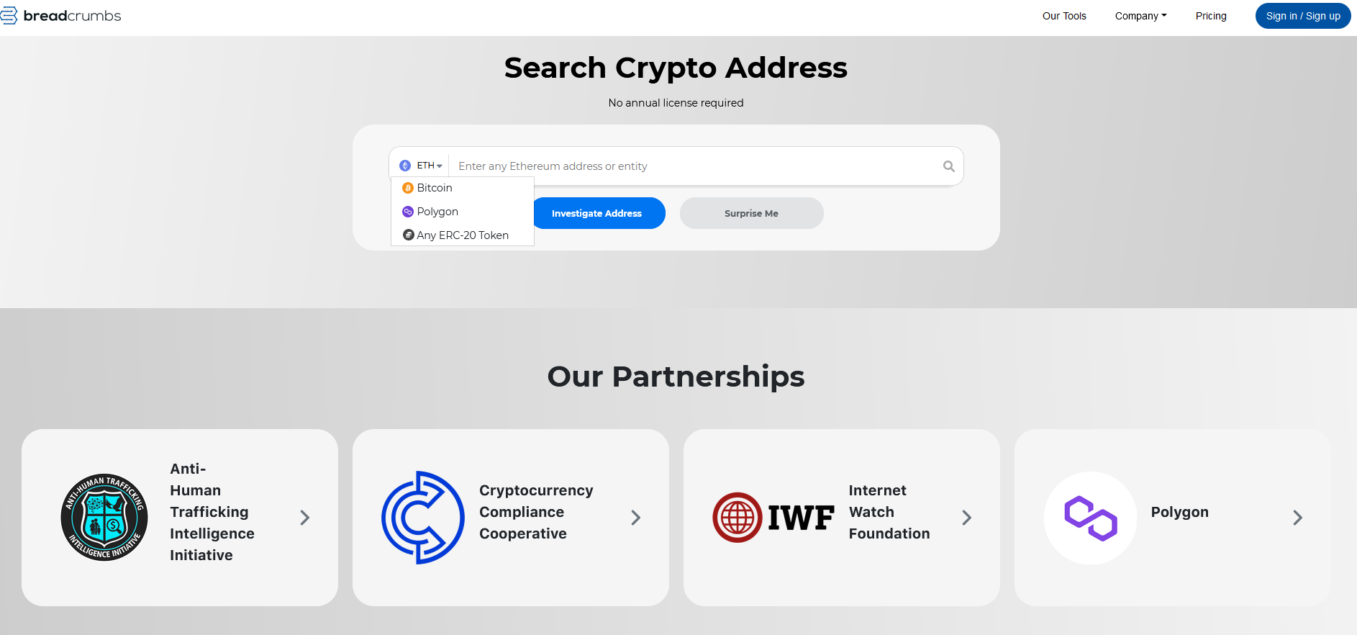
https://www.breadcrumbs.app

Slide 8
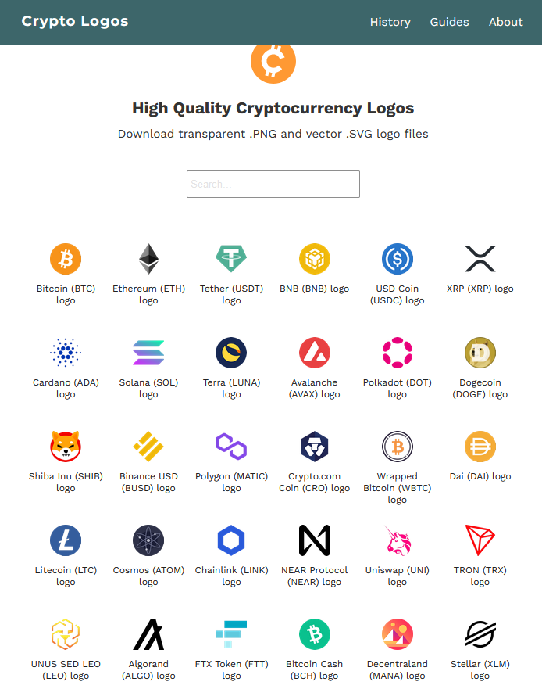
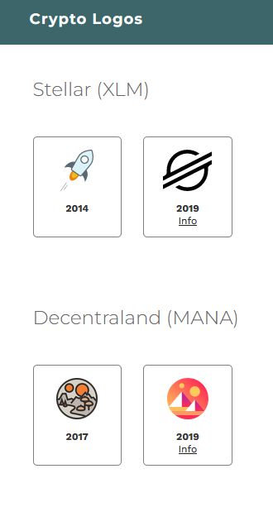
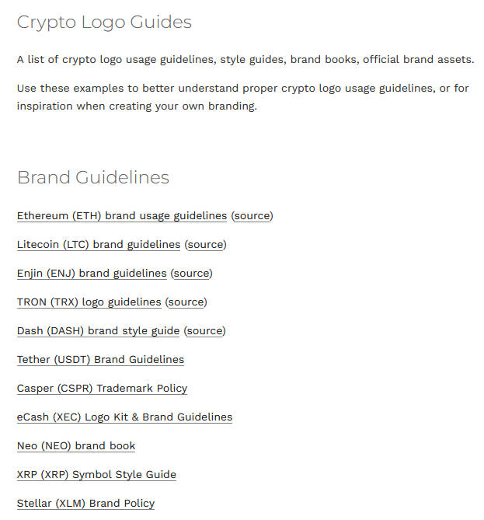
https://cryptologos.cc/
Historical View
Brand Guidelines

Slide 9
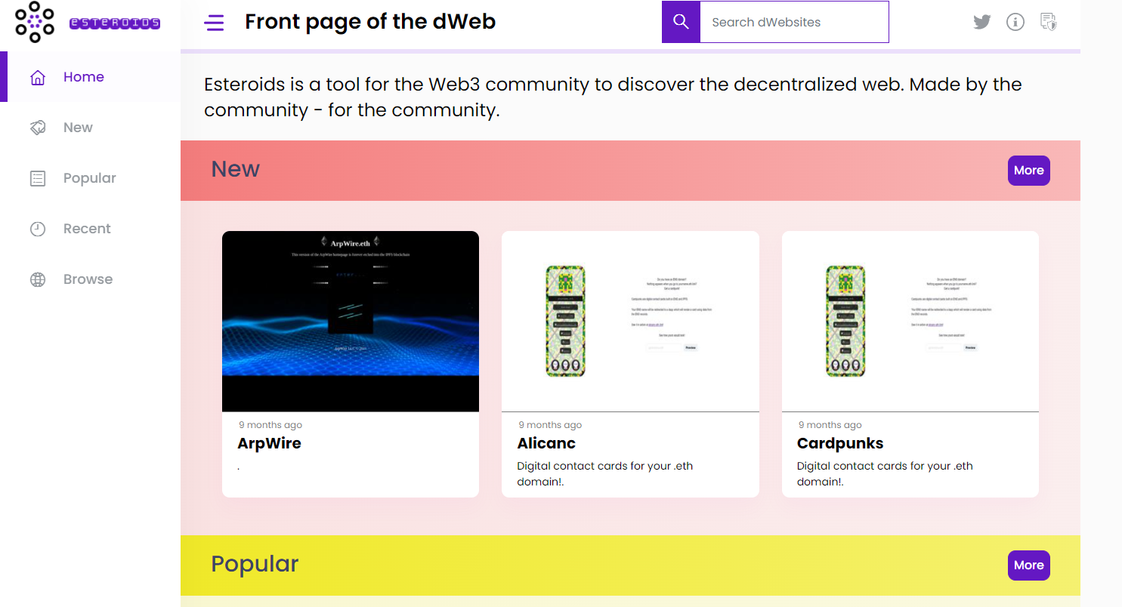
Front page of the dWeb
Esteroids – Discover more dWebsites
This is a decent place to look up more of the sites per topics.
Should resolve the sites to any browser but many of the projects are broken linked…
https://esteroids.xyz/#/

Slide 10
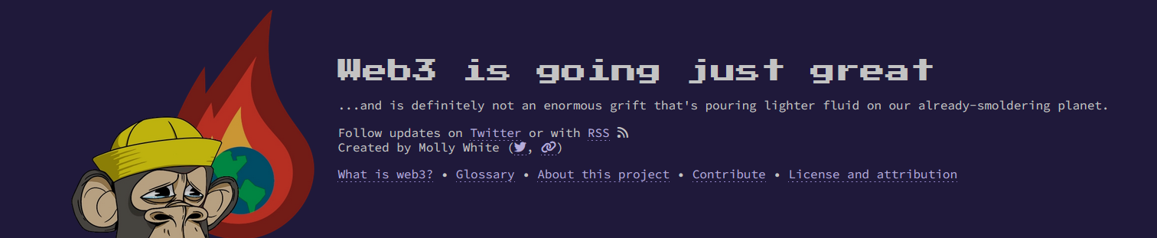
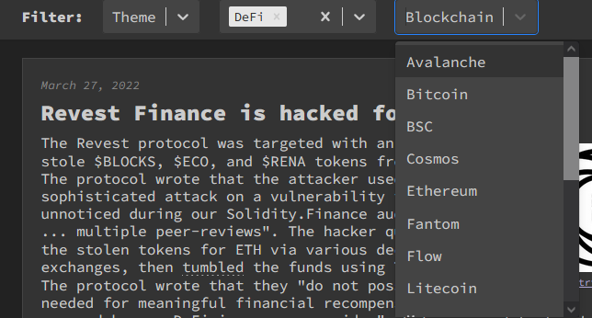

https://web3isgoinggreat.com

Slide 11
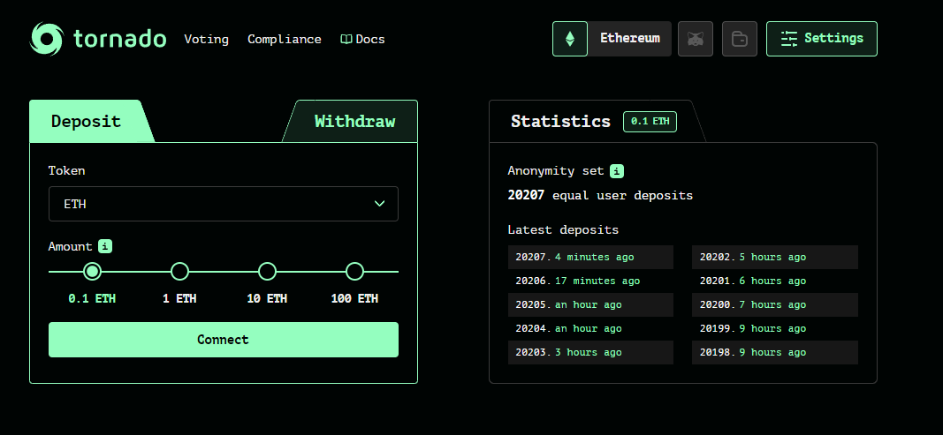

Slide 12
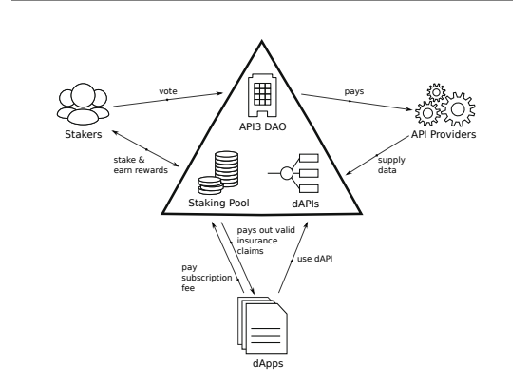
Web3 Related Technologies
IPFS/IPNS
GraphQL
Infura.io

Slide 13
IPFS/IPNS
Inter Planetary File System / Inter Planetary Name System
IPNS is mutable, IPFS is immutable.
Storage for images
Used for NFT projects or links as “pinned” or hosted images
Allows for content to resolve via browser over “gateways”
If you know about OnionShare, you have the basic idea of IPFS
If you don’t know…you host it on your local machine but if that machine is off, no more content..

Slide 14
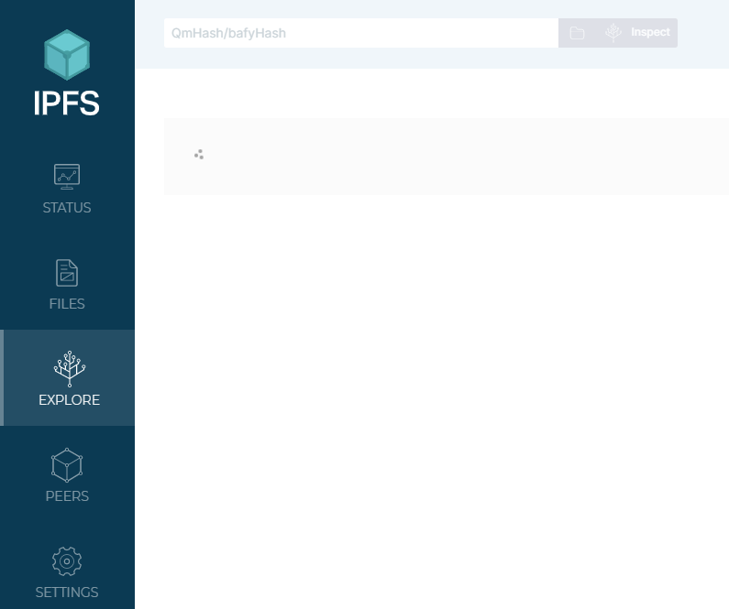
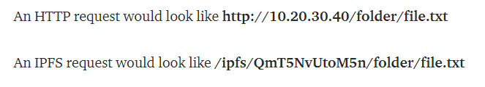
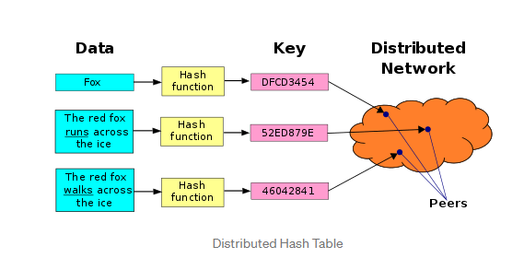
IPFS == Bittorrent + Git + HTML
https://medium.com/wolverineblockchain/what-is-ipfs-b83277597da5

Slide 15
GraphQL
Can search IPFS
Used by many Blockchain project
The Graph - https://thegraph.com/docs/en/explorer/
Next generation API query.
Instead of REST API, this is a single query with specific data point that can be requested

Slide 16
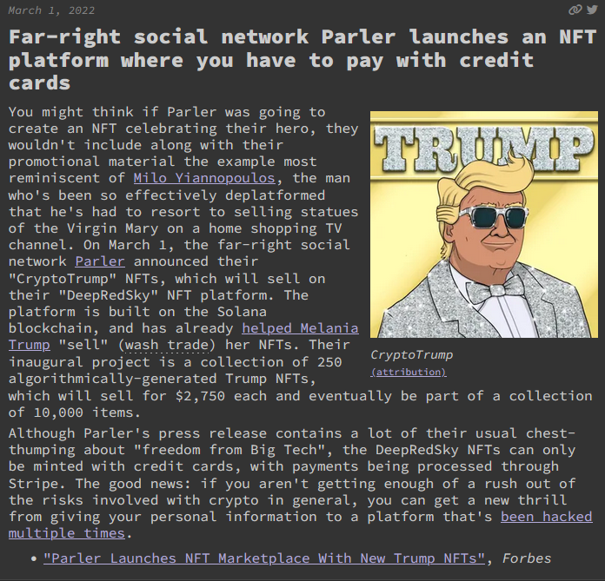
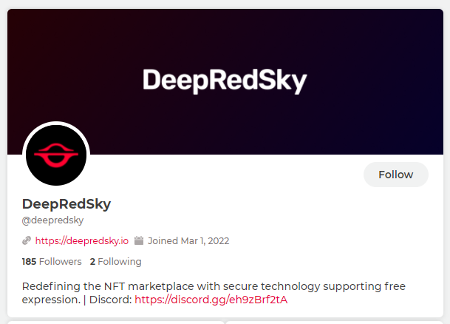
https://parler.com/deepredsky
https://www.forbes.com/sites/abrambrown/2022/03/01/parler-launches-nft-marketplace-with-new-trump-nfts/?sh=8c7f61613c43

Slide 17
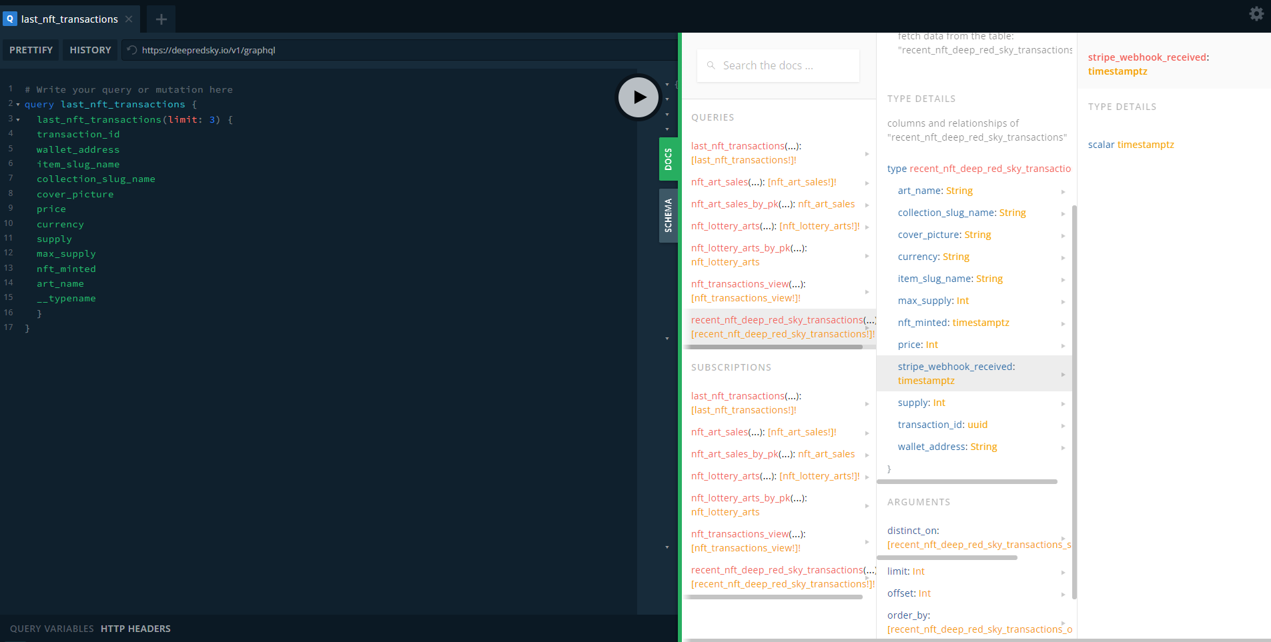
DeepRedSky - GraphQL
https://api.ideavate.co/v1/graphql
https://apis.guru/graphql-voyager/

Slide 18
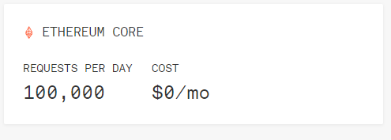
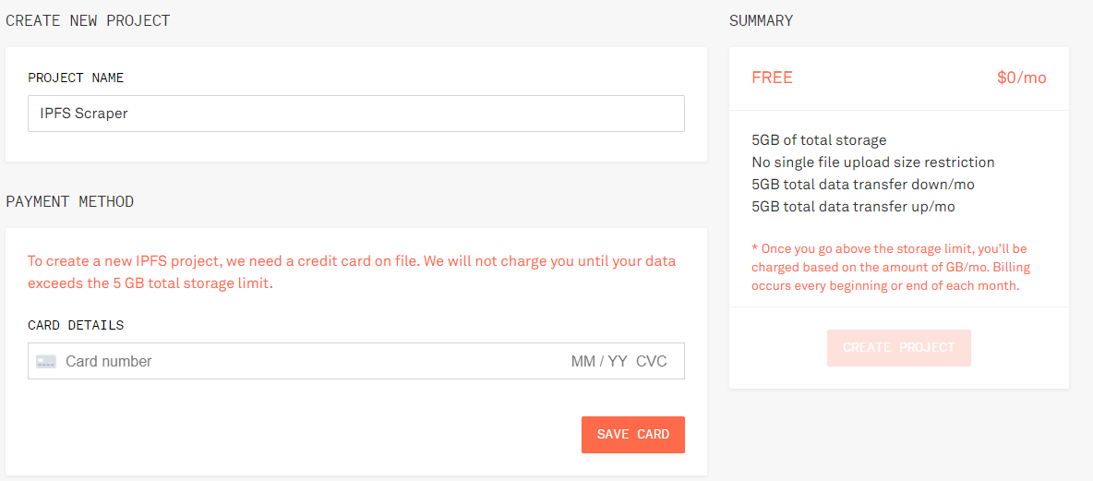
Infura.io
Informational layer for:
Ethereum –see Jeff’s talk
ETH layer 2 – See Vitalik
IPFS – see previous slides
Filecoin – more storage blockchain project

Slide 19
DAO/DEFI
Decentralized Autonomous Organization
Twitter mob with wallets
Token holder are granted voting rights. More token more weight in voting…
Must express a wallet in the DAO – perfect for scraping…
Decentralized Finance
Internet banking with better APY than a saving account (sad but true)
Some of the projects are DAO, some are not – no regulations on conduct or investments
Some projects are anonymous – DYOR

Slide 20
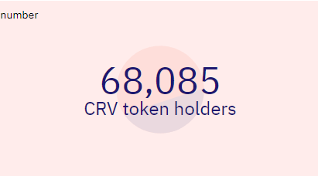

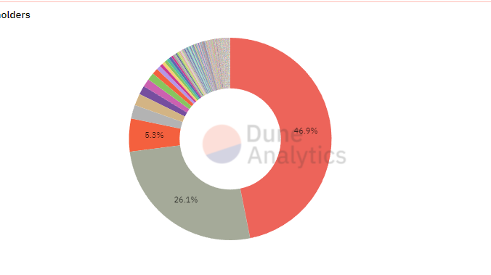
DAO Research
Curve.fi – DAO – Stablecoin trading platform – Somewhat DEFI as well
Dune.xyz
Curator list of scraped projects with visual analytics
They Service NFT projects and DAO/DEFI

Slide 21

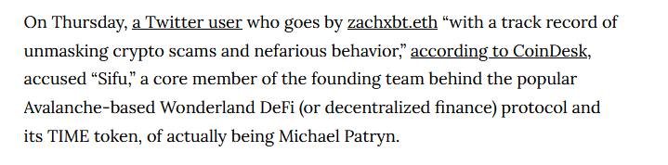
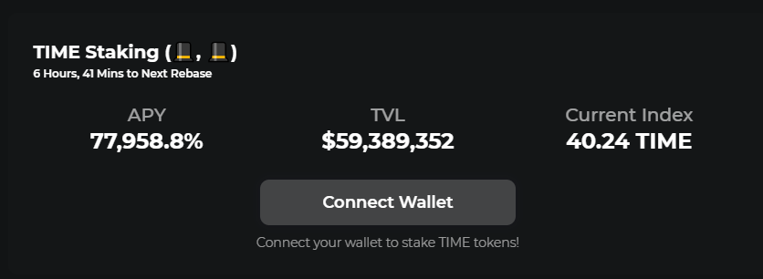

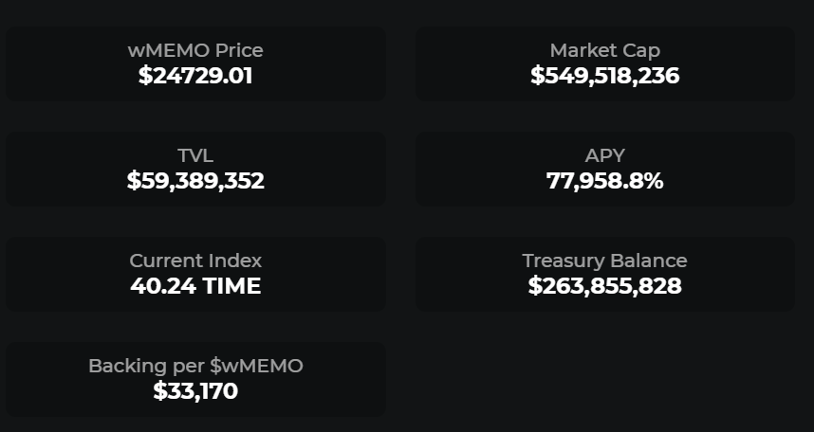
Decentralized Finance
https://investigations.notion.site --- @zachxbt on twitter
https://twitter.com/danielesesta/status/1486591436233404421
https://www.vice.com/en/article/epxakz/crypto-co-founder-revealed-to-be-infamous-fraudster-investors-shaken

Slide 22
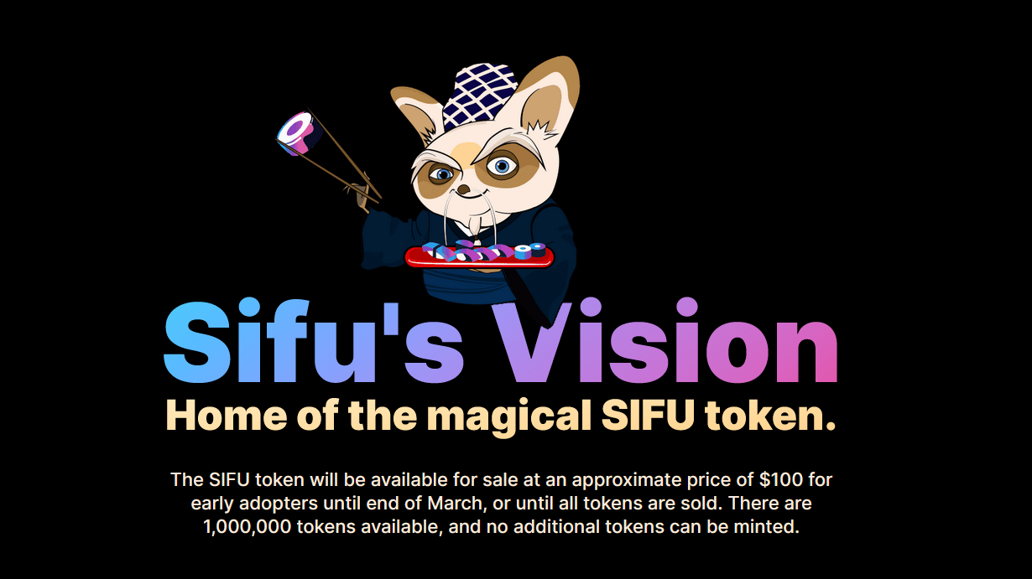

Slide 23
Decentralized Social Media
LBRY – Youtube clone
KARMA -
Dtube
Steemit – Might be dead?
Uptrennd
Indorse – LinkedIn of Blockchain
Minds – Mirco Blog spot
Peepeth -
Twetch
Hive Blog
Trybe
Sapien.network
Aether
Mastodon – not blockchain but P2P

Slide 24
ENS/UNS see guide in GitHub for detailed browser setting…
ENS Domains
Most popular – based on ETH blockchain
.eth TLD
Unstoppable Domains TLD
.zil
.crypto
.coin
.wallet
.bitcoin
.x
.888
.nft
.dao

Slide 25

Using OSINT to assist with Web3 investigations

Slide 26
Traditional OSINT method
Welcome to CryptoLand (Real project)
Cryptoland.is
Very scary “Vision Video” (The mascot is named Connie…like Con-you-out-of-money?)
API Access to the wallet and the external site.
Little more digging and we find the XML site map for the project
This leads us to a Google Storage Space that allows us to see all 10000 NFT images (no traits or metadata but you can right click all you want….)
Let check this out.

Slide 27
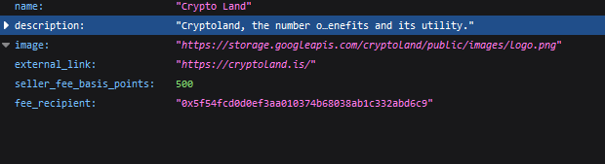

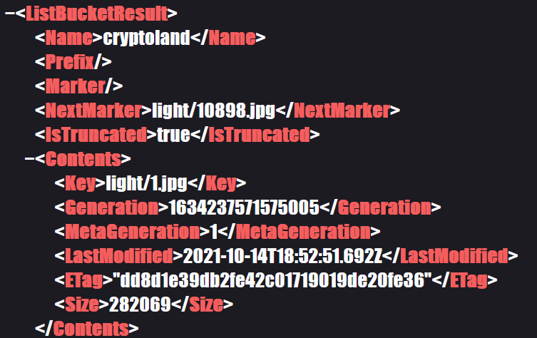
https://api.cryptoland.is/v1/website
https://storage.googleapis.com/cryptoland
https://storage.googleapis.com/cryptoland/light/9004.jpg

Slide 28
Traditional OSINT method
ENS domains tracking
Random domains – locating.eth
What information can we get from Traditional OSINT sources?
This is a very brief demonstration
Let check this out.

Slide 29
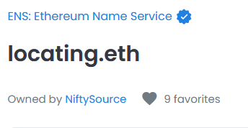
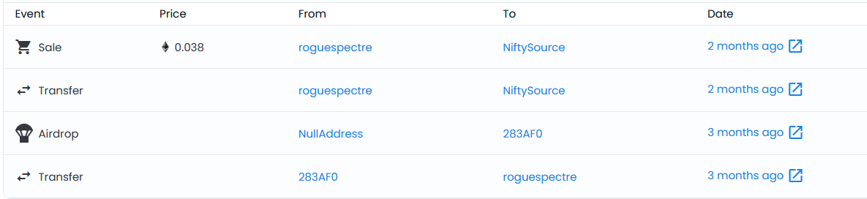
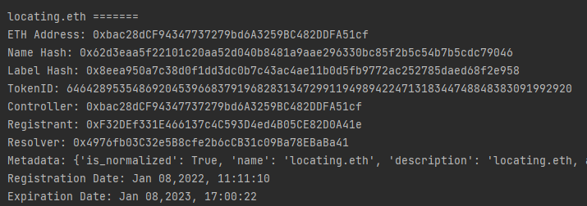


Slide 30
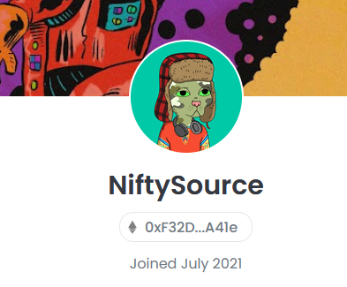
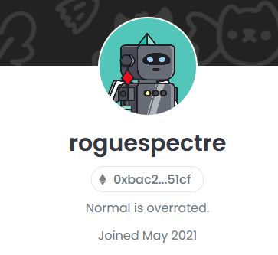
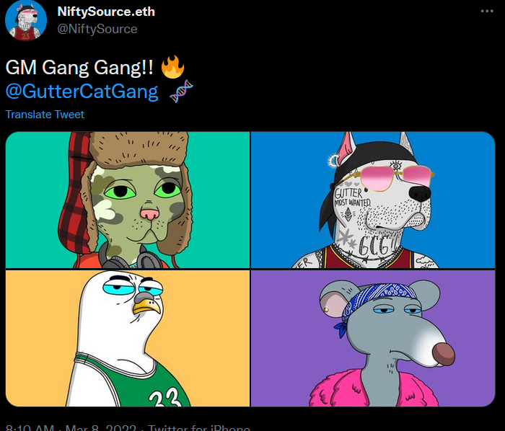
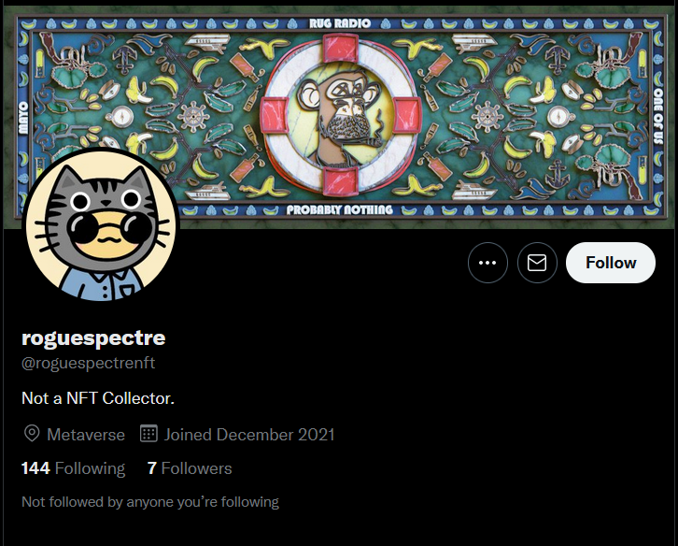
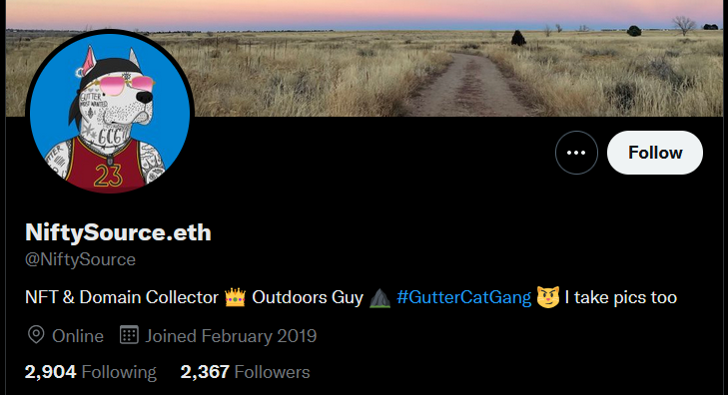
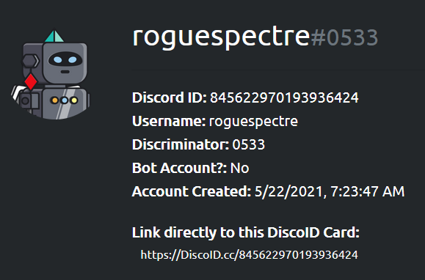
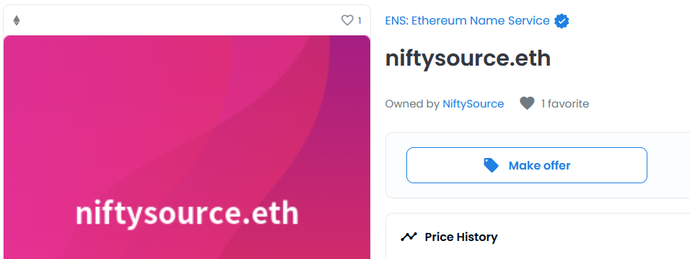

Slide 31
Traditional OSINT method
FlyFish Club
Who owns or is invested in the start up?
What can we learn about the club/token holders?
What other details can a real investigation reveal?

Slide 32
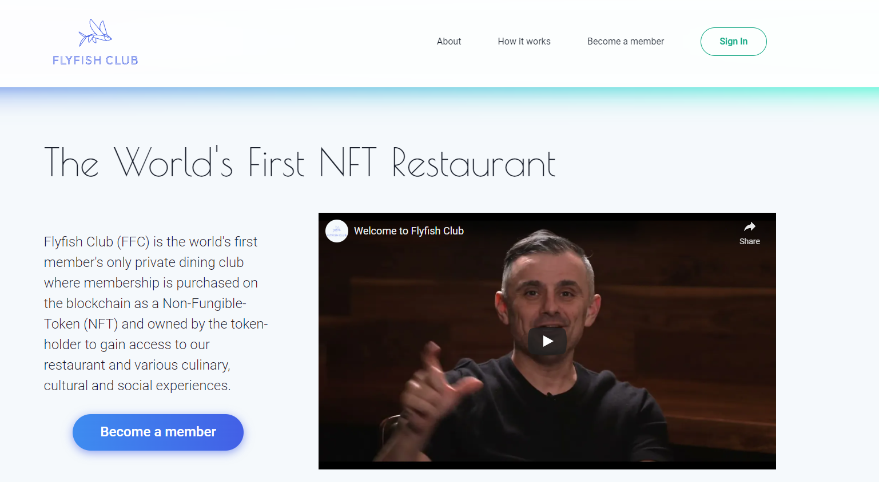
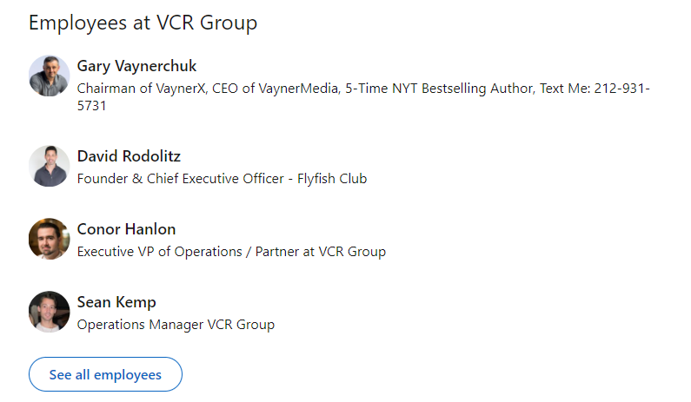
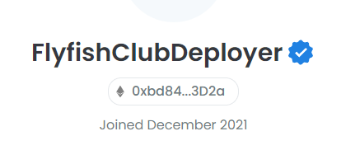

Slide 33
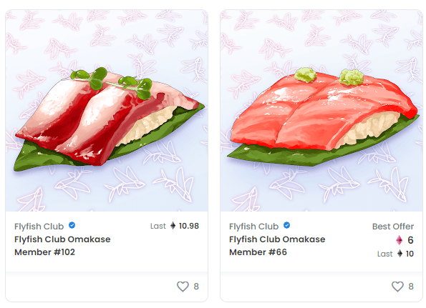
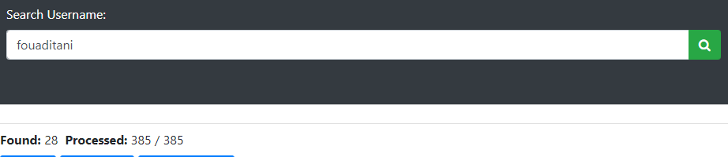
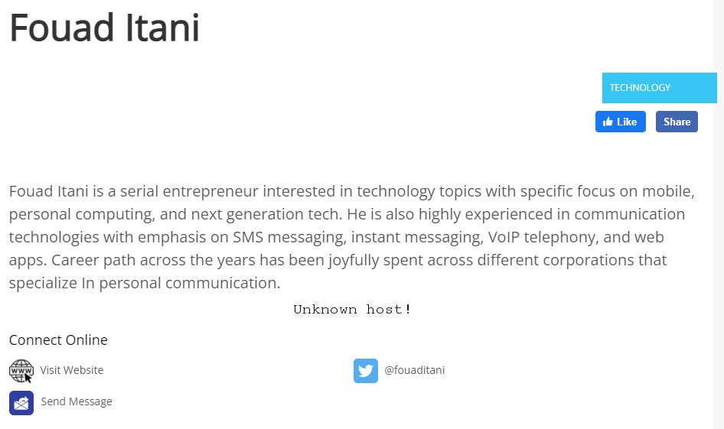

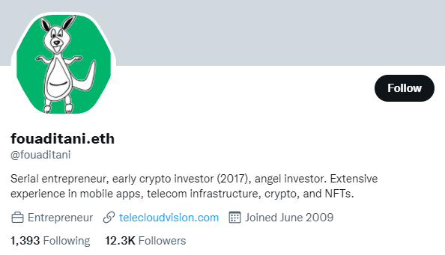
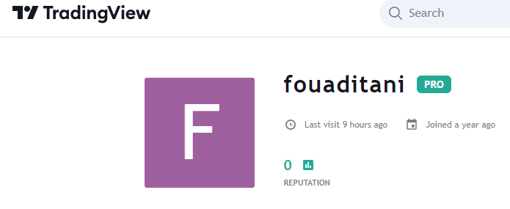

Slide 34
Tool release
ENS domain script
The script will resolve the Owners wallet address
The script will check for TEXT records information
This can include Discord, Twitter, URL, Avatar information, and email details
It will also resolve the “metadata” for the NFT domains
Registration Date
Expiration Date
It will save all of it to a file for more fun later on….

Slide 35
Tool Release
Can you do all this manually? -- Yes…but what fun is that?
Where can you find this information manually?
OpenSea – basic info with transaction records
EtherScan – more detailed record with transactions, other .eth domains and Text record
Blockchain nodes – everyone is gathering the information from the chains. Its all api calls. Everything old is new again….

Slide 36
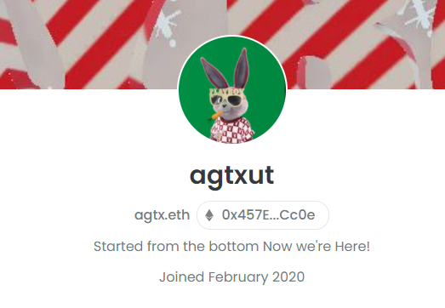

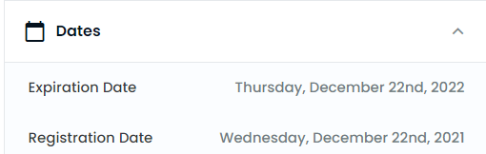
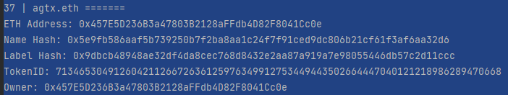

Slide 37


Slide 38


Slide 39
Questions?
Future areas of research:
Other specific chains that we can gather details from
NFT Gaming
User enumeration
Information collection
Metaverse and VR/AR
Existing VR and new companies
What can we learn from that landscape?

Slide 40
Remember!!!
Stay OSINT Curious!!!!

